Slide 1
FREEBIES FOR NEWBIES
A place to find free event and items
Team Members:
Aditya Krishna Raavi
Manoj Kumar Gude
Saibabu Devarapalli
Jaichand Mulakalapalli
Harish Chowdary Bala
Client & Mentor:
Dr. Chandra Mouli Kotteti

Slide 2
Team Members
MANOJ KUMAR GUDE
FRONTEND
ADITHYA KRISHNA RAAVI
FRONTEND
SAIBABU DEVARAPALLI
FULLSTACK
JAICHAND MULAKALAPALLI
(TEAM LEADER) BACKEND
HARISH CHOWDARY BALA
DATABASE
DR. CHANDRA MOULI
KOTTETI
Mentor & Client

Slide 3
Table of Contents
Introduction
Reuse layouts with <include>
<merge> Tag
Simple Widget
Roles
Android Dialogue Builder
Lessons Learned
Summary
Emulators
Admin Roles
User Roles
Modularization

Slide 4




Introduction
Freebies for Newbies is an android application.
To develop this application, we used agile software methodology.
By this application we help international students to find free Items and Events in the desired location.
Many of the international students doesn’t know about events happening in college
Tools used:

Slide 5
Emulators
An Android Emulator is a Software Application that allows your mobile to imitate Android OS Features into our PC’s.
They are some built in Emulators in the Android. Other than that we are having a some open source and commercial emulators.
List of emulators are BlueStacks, LDPlayer, NoxPlayer ,Memu , GenyMotion ,ARChon ,Android-x86 ,KoPlayer , etc.
Each Emulator has its own features ,Pros and Cons.
User Requirements they can pick the desired one.
Benefits of using Android Emulator Software
Large displays in computers has better controls of the user applications.
We don’t need to care about the battery life of Android Devices.
Notes:
Ref :- https://www.guru99.com/best-android-emulators-mac-windows.html.

Slide 6
Modularization
To reuse and maintain the code in Android.
If you’re project grows day by day in size it is difficult to handle the code so for that we use Modularization technique.
For Most of the Android application consist of a single app module which is the cause for the issue.
DisAdvantages :- Reusability and Maintainability.
Here comes the play into the Modularization:-
Reusability The modules are completely reusable.
Co-Operation For developer Purposes.
Build We can build each and every module separately rather than building the whole operation.
Testing It can be improved by writing specific modu;es
Maintainability Decoupled code is maintainable

Slide 7
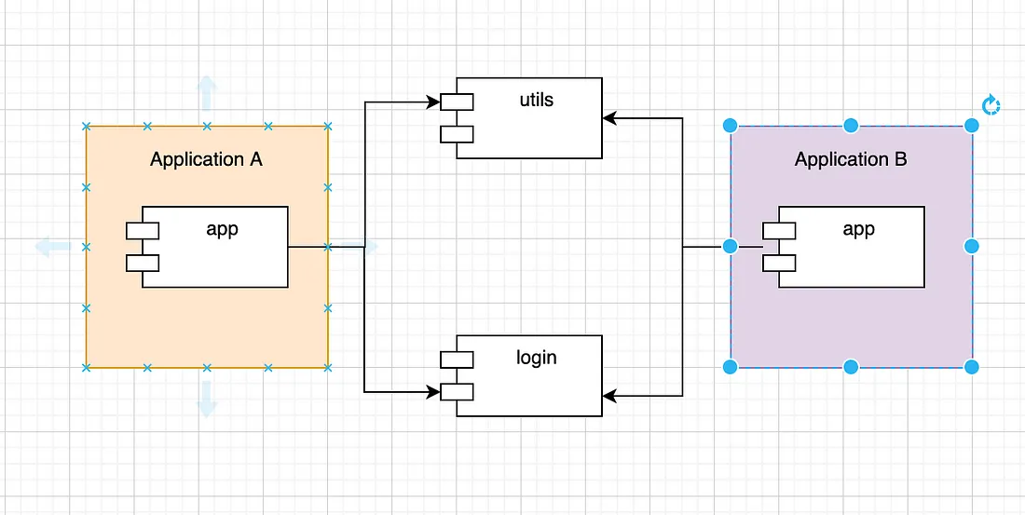
Modularization
Fig 1. Modularization

Slide 8
Reuse layouts with <include>
Include a special layout used to reuse the larger components.
Reusing layouts is particularly powerful as it allows you to create reusable complex layouts.
For example, in our application we have reused the menu bar in every activity
For this, the common elements across multiple layouts can be extracted.
Inside the layout to which you want to add the reusable component, add the <include> tag.
<include layout = “@layout/titlebar”/>

Slide 9
<merge> Tag
The merge tag helps eliminate redundant view groups in your view hierarchy when including one layout within another.
For example, if your main layout is a vertical linear layout in which two consecutive views can be reused in multiple layouts.
Then the reusable layout in which you place the two views requires its own root view.
By this nested layout were creating, to avoid this we are using <merge> tag.
Here merge is the root view for the reusable layout.

Slide 10
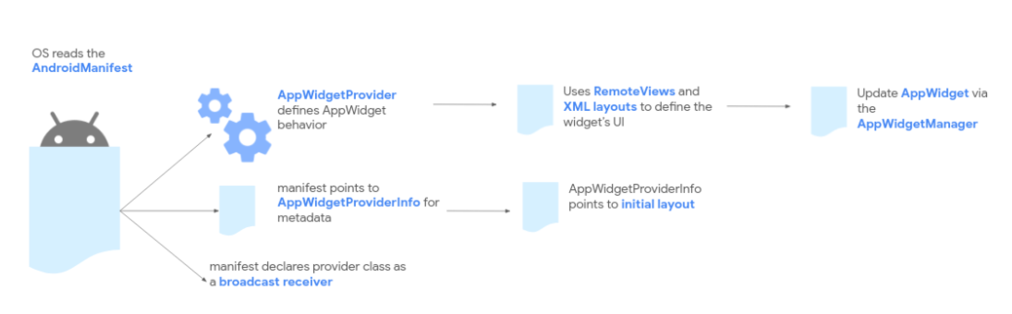
Simple Widget
App widgets are miniature application views that can be embedded in other applications (such as the home screen) and receive periodic updates.
These views are referred to as widgets in the user interface, and you can publish one with an app widget provider .
An app component that is able to hold other widgets is called an app widget host.
Fig 2 : App Widget Illustration

Slide 11
Roles
Types: admin, user, guest, and viewer.
These roles determine the level of access and privileges the user has within the application, such as the ability to perform certain actions or access certain data.
The Role Manager class in the Android API allows apps to request specific roles, and developers can define and assign roles as needed for their applications.

Slide 12
Admin Roles
Admin role grants full access to application features and functions, including managing content and users.
Admin main roles in our Application are:
Approve/Deny New Requests
Approve/Deny Update Requests
Approve/Deny Delete Requests
Admin has exclusive access to back4app database to manage data.

Slide 13
User Roles
Regular user role has limited access to application features, mainly allowing only viewing and interaction with the content.
User role privileges in our Application are:
View Latest Events and free Items available
Raise Update Requests to get the latest data
Raise Delete Requests if the Event/Items no longer available
User has limited access to back4app database to view/write data.

Slide 14
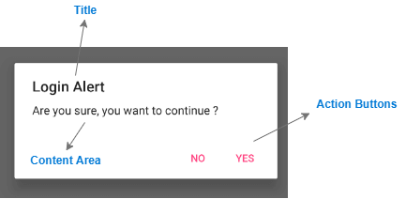
Android Dialogue Builder
The Android Dialogue Builder is a tool for creating dialogs in Android, which are used for interaction with the user.
Dialogs are an important part of the user interface, as they allow developers to communicate information, prompt for input, or display errors in a modal window.
The Android Dialogue Builder makes it easy to create and customize dialogs, as well as manage their behavior and lifecycle.
Fig 3 : Sample Alert Dialog Box

Slide 15
Android Dialogue Builder (Code part1)
AlertDialog.Builder builder = new AlertDialog.Builder(this);
builder.setTitle("Dialog Title");
builder.setMessage("Dialog Message");
builder.setPositiveButton("OK", new DialogInterface.OnClickListener() { @Override public void onClick(DialogInterface dialog, int which) {
//Write your code here to perform action when OK is clicked
}
});
Fig 4 : Code snippet part 1

Slide 16
Android Dialogue Builder (Code part2)
builder.setNegativeButton("Cancel", new DialogInterface.OnClickListener() { @Override public void onClick(DialogInterface dialog, int which) { P
//Write your code here to perform action when Cancel is clicked
action }
});
AlertDialog dialog = builder.create();
dialog.show();
Fig 5 : Code snippet part 2

Slide 17
Lessons Learned
In the recent sprints, we have been working on implementing administrative functionalities to approve user requests and store the data in a single table.
However, this approach resulted in unnecessary data replication and an insufficient data model for tracking different types of requests (Example: new event requests, update event requests, delete event requests).
To resolve this issue, we have decided to create separate tables for each type of request.

Slide 18
Summary
Dialogs are crucial for developers to communicate, prompt, or display errors.
Android Dialogue Builder simplifies creation, customization and behavior management of dialogs.
Inefficient data storing techniques for handling user requests and tracking led to separate tables being created for each request type.

Slide 19
References
Image sources:
Back4App: https://www.back4app.com/
Android Studio: https://developer.android.com/studio
GenyMotion: https://www.genymotion.com/
VirtualBox: https://commons.wikimedia.org/wiki/File:Virtualbox_logo.png
Alert Dialog box: www.tutlane.com
Project links:
https://github.com/Sec03Team05Fall22GDP1/FreebiesforNewbies

Slide 20

Thank You Everyone..!
Any Queries

Slide 21
Team Members
MANOJ KUMAR GUDE
FRONTEND
ADITHYA KRISHNA RAAVI
FRONTEND
SAIBABU DEVARAPALLI
FULLSTACK
JAICHAND MULAKALAPALLI
(TEAM LEADER) BACKEND
HARISH CHOWDARY BALA
DATABASE
DR. CHANDRA MOULI
KOTTETI
Mentor & Client

Slide 22
FREEBIES FOR NEWBIES
A place to find free event and items
Team Members:
Aditya Krishna Raavi
Manoj Kumar Gude
Saibabu Devarapalli
Jaichand Mulakalapalli
Harish Chowdary Bala
Client & Mentor:
Dr. Chandra Mouli Kotteti

